Slide 1
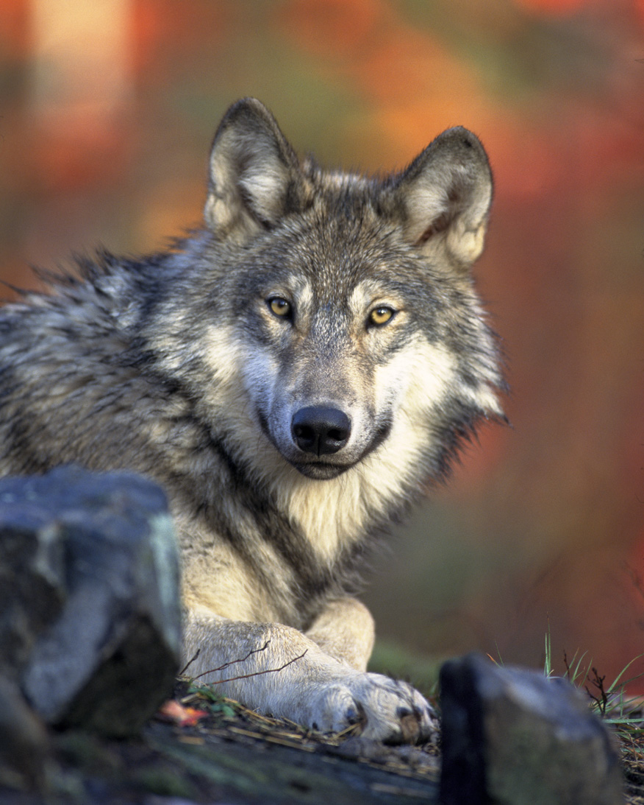
AM I DOING MY PART?

Slide 2
After a 70 year absence, wolves were reintroduced into Yellowstone National Park in 1995

Slide 3
Wolves made things much better for plants and animals
Overgrazing by deer and elk decreased
Aspen, willow, and cottonwood trees again grew
Beaver returned to make ponds which helped otter, duck, muskrat, fish, reptiles, and amphibians
Trees remarkably grew at 5 times the rate they had grown previously
Erosion along streams and lakes decreased
Migratory song birds numbers increased dramatically
Fish and aquatic animals grew in numbers
Less coyotes (because of wolves) meant more rabbits and mice (food) for hawks, fox, weasels, and badgers
Ravens and eagles fed on carrion left by the wolves
More plants and shrubs produced berries which helped to have more bears

Slide 4
Wolves made things much better for the rivers!
There was less erosion.
More pools formed and more riffle sections, which were great for wildlife and fish habitats
The regenerating forests stabilized the river banks so that they collapsed less often, so rivers became more fixed in their course
By driving the deer out (for decades Yellowstone was overgrazed) of some places and the vegetation recovering on the valley sides, there was less soil erosion, because the vegetation stabilized
Wolves, small in number, transformed the ecosystem and physical geography of the 2,219,791 acre Yellowstone National Park!

Slide 5

By one animal being introduced and by one animal doing it’s part, everything got better! The natural balance God had created was restored.

Slide 6
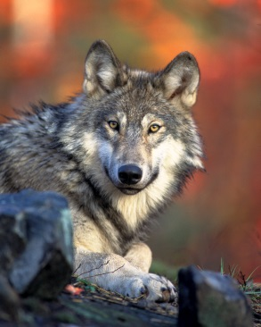
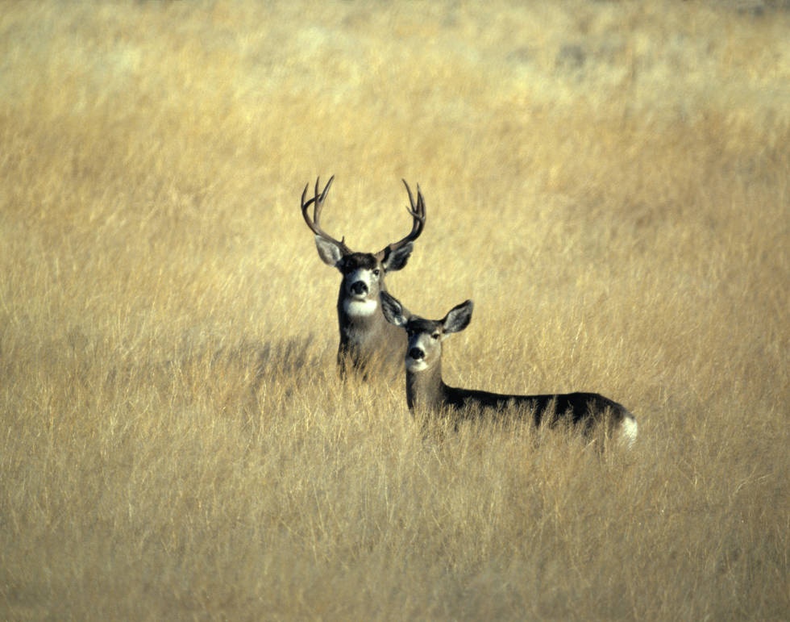
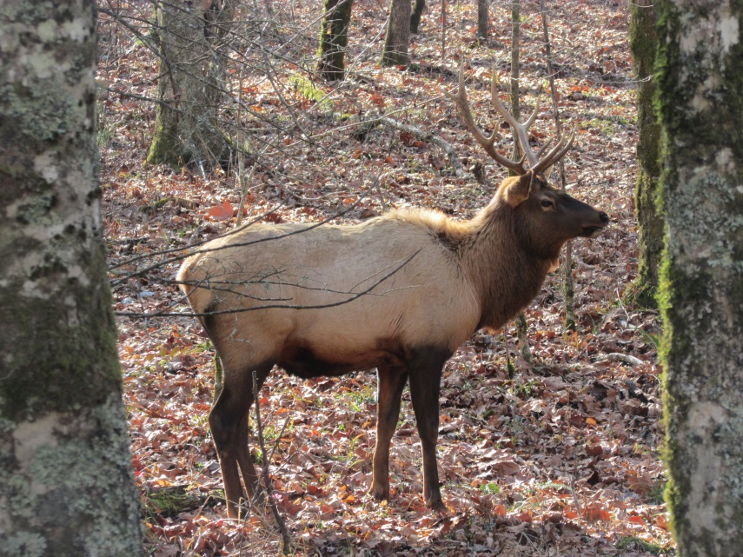
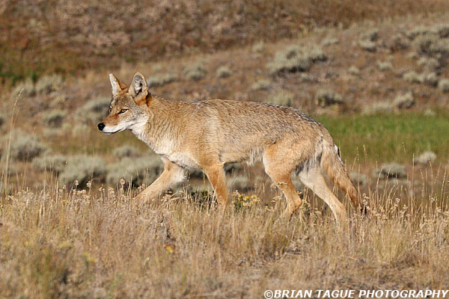

Slide 7
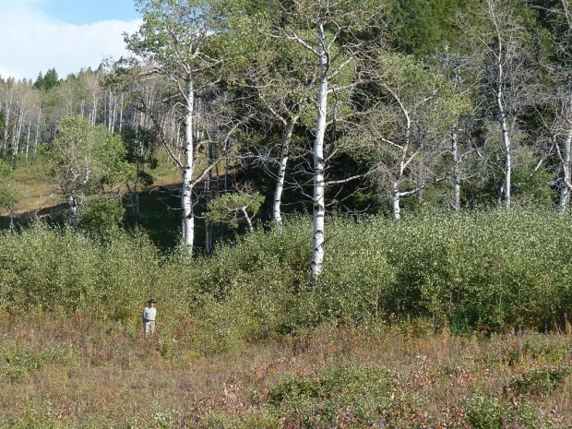
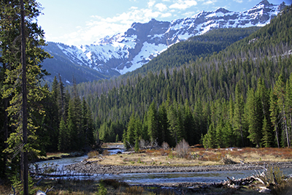
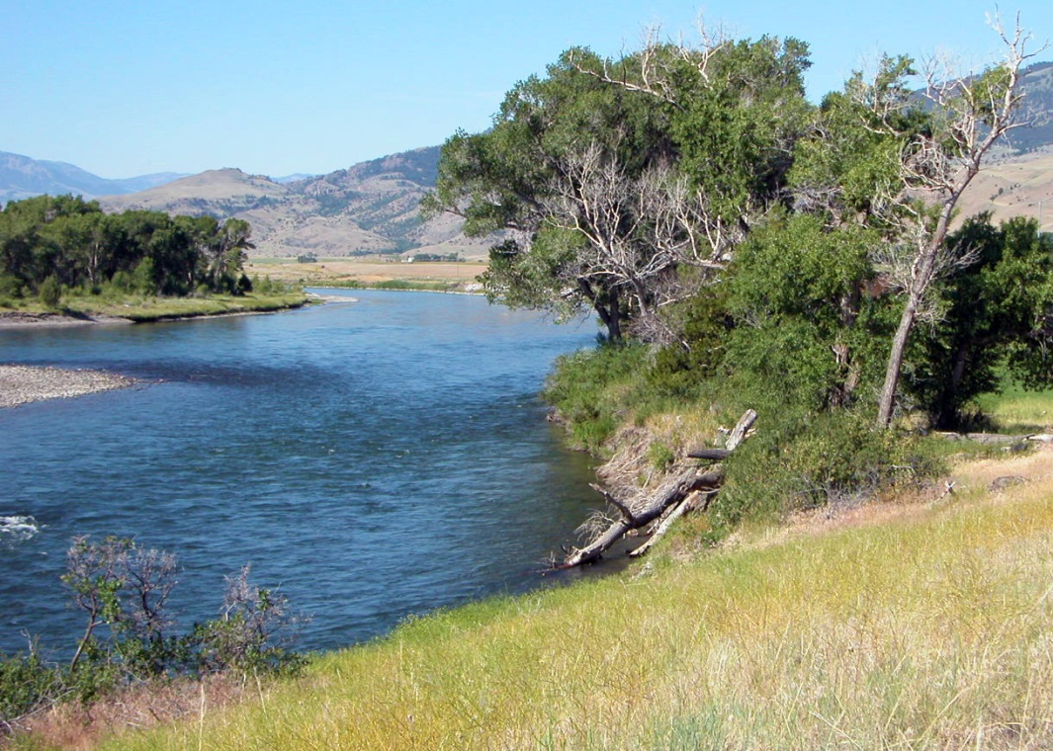
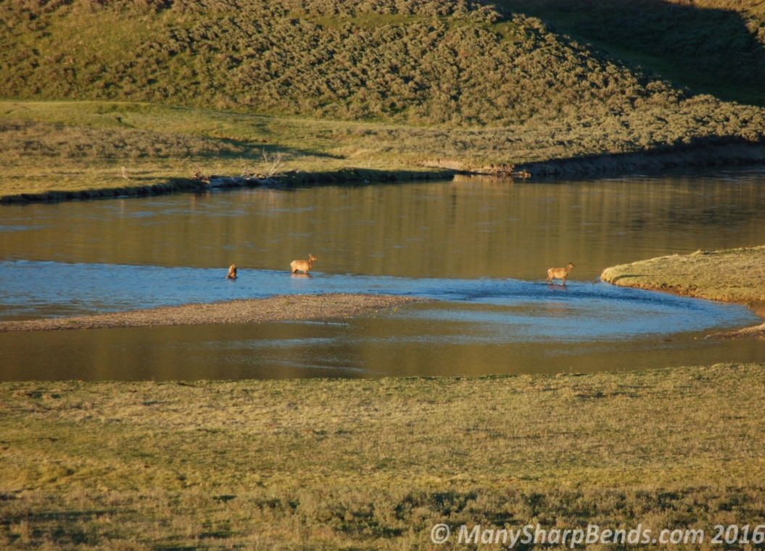

Slide 8
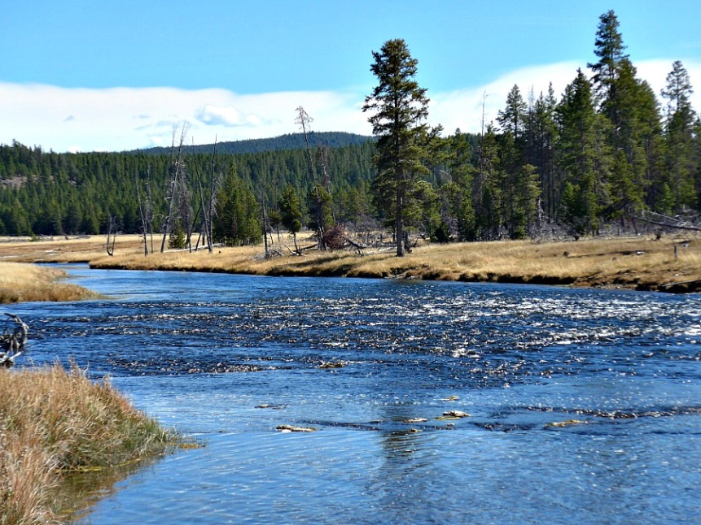
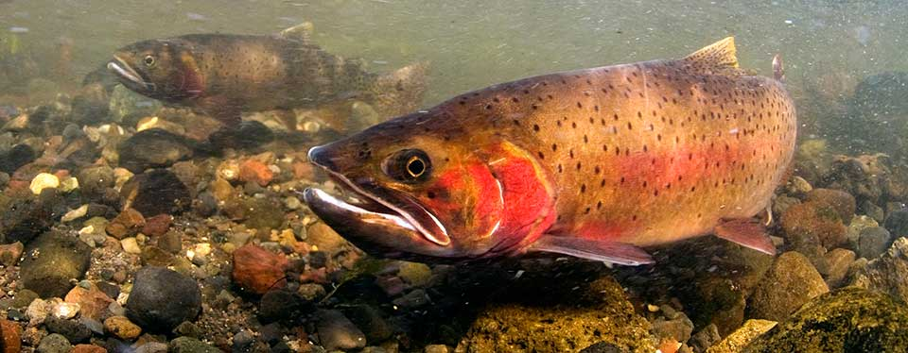
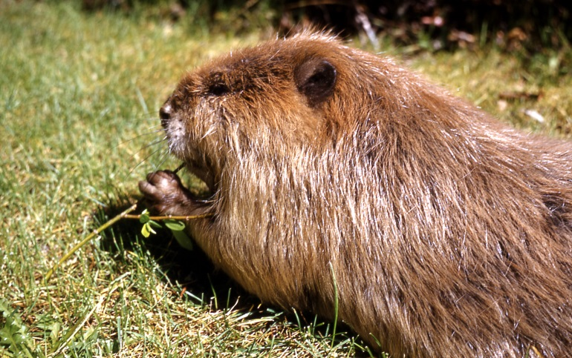
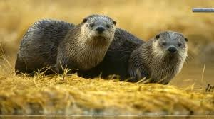
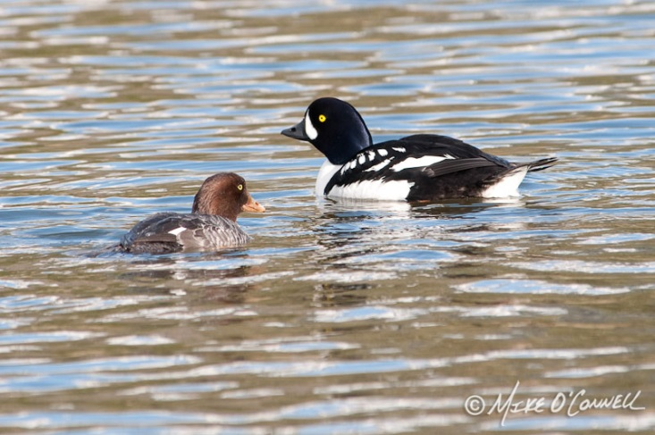

Slide 9
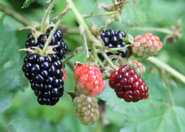
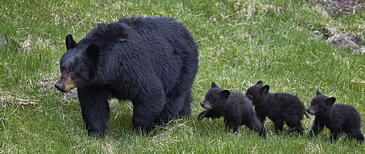
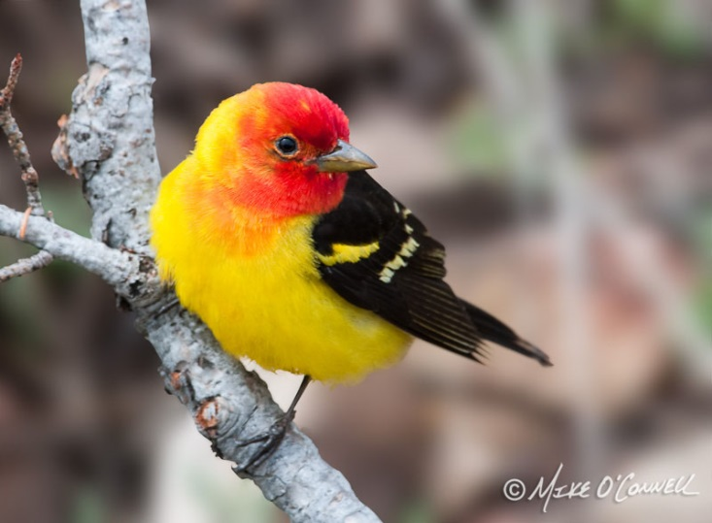
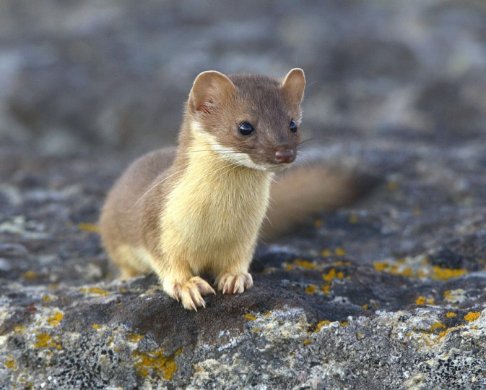
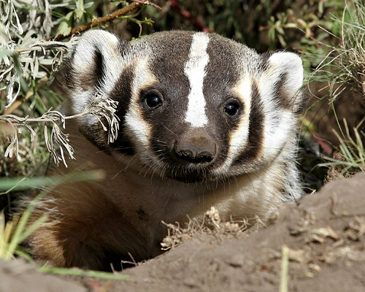
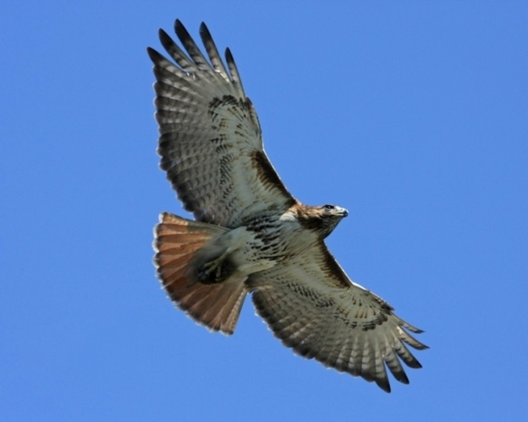
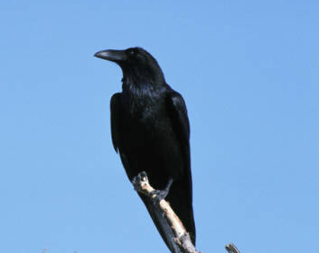
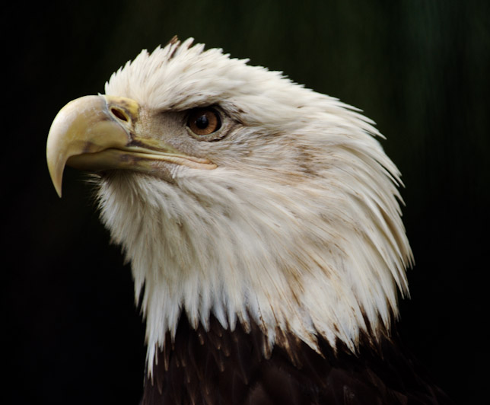

Slide 10
We individual Christians, by each one doing our part, can make everything better!
  Our homes
  Our workplaces
  Our neighborhoods
  Our communities
  Our congregation

Slide 11
It starts with me knowing what God wants me to do to be pleasing to him.
John 14:15 (NKJV): “If you love Me, keep My commandments.”
2 Timothy 2:15 (NKJV): “Be diligent [Study (KJV)] to present yourself approved to God, a worker who does not need to be ashamed, rightly dividing [handling (ESV)] the word of truth.”
2 Timothy 3:16-17 (NKJV): “All Scripture is given by inspiration of God, and is profitable for doctrine, for reproof, for correction, for instruction [training (ESV)] in righteousness, that the man of God may be complete, thoroughly equipped for every good work.”

Slide 12
Now we want to look at scriptures that remind us of what Christians should be doing.

Slide 13
Mark 12:29-31 (NKJV): “Jesus answered him, ‘The first of all the commandments is: “Hear, O Israel, the LORD our God, the LORD is one. And you shall love the LORD your God with all your heart, with all your soul, with all your mind, and with all your strength.” This is the first commandment. And the second, like it, is this: “You shall love your neighbor as yourself.” There is no other commandment greater than these.’”

Slide 14
Matthew 7:12 (NKJV): “Therefore, whatever you want men to do to you, do also to them, for this is the Law and the Prophets.”
Matthew 7:24 (NKJV): “Therefore whoever hears these sayings of Mine, and does them, I will liken him to a wise man who built his house on the rock”

Slide 15
Romans 12:1-2 (NKJV): “I beseech you therefore, brethren, by the mercies of God, that you present your bodies a living sacrifice, holy, acceptable to God, which is your reasonable service. And do not be conformed to this world, but be transformed by the renewing of your mind, that you may prove what is that good and acceptable and perfect will of God.”

Slide 16
Romans 12:4-8 (NKJV): “For as we have many members in one body, but all the members do not have the same function, so we, being many, are one body in Christ, and individually members of one another. Having then gifts differing according to the grace that is given to us, let us use them: if prophecy, let us prophesy in proportion to our faith; or ministry, let us use it in our ministering; he who teaches, in teaching; he who exhorts, in exhortation; he who gives, with liberality; he who leads, with diligence; he who shows mercy, with cheerfulness.”

Slide 17
Romans 12:9-21 (NKJV): “Let love be without hypocrisy. Abhor what is evil. Cling to what is good. Be kindly affectionate to one another with brotherly love, in honor giving preference to one another; not lagging in diligence, fervent in spirit, serving the Lord; rejoicing in hope, patient in tribulation, continuing steadfastly in prayer; distributing to the needs of the saints, given to hospitality. Bless those who persecute you; bless and do not curse. Rejoice with those who rejoice, and weep with those who weep. Be of the same mind toward one another. Do not set your mind on high things, but associate with the humble. Do not be wise in your own opinion. Repay no one evil for evil. Have regard for good things in the sight of all men. If it is possible, as much as depends on you, live peaceably with all men. Beloved, do not avenge yourselves, but rather give place to wrath; for it is written, ‘Vengeance is Mine, I will repay,’ says the Lord. Therefore ‘If your enemy is hungry, feed him; If he is thirsty, give him a drink; For in so doing you will heap coals of fire on his head.’ Do not be overcome by evil, but overcome evil with good.”

Slide 18
1 Corinthians 16:2 (NKJV): “On the first day of the week let each one of you lay something aside, storing up as he may prosper, that there be no collections when I come.”
2 Corinthians 9:6-7 (NKJV): “But this I say: He who sows sparingly will also reap sparingly, and he who sows bountifully will also reap bountifully. So let each one give as he purposes in his heart, not grudgingly or of necessity; for God loves a cheerful giver.”

Slide 19
Galatians 6:1-10 (NKJV): “Brethren, if a man is overtaken in any trespass, you who are spiritual restore such a one in a spirit of gentleness, considering yourself lest you also be tempted. Bear one another's burdens, and so fulfill the law of Christ. For if anyone thinks himself to be something, when he is nothing, he deceives himself. But let each one examine his own work, and then he will have rejoicing in himself alone, and not in another. For each one shall bear his own load. Let him who is taught the word share in all good things with him who teaches. Do not be deceived, God is not mocked; for whatever a man sows, that he will also reap. For he who sows to his flesh will of the flesh reap corruption, but he who sows to the Spirit will of the Spirit reap everlasting life. And let us not grow weary while doing good, for in due season we shall reap if we do not lose heart. Therefore, as we have opportunity, let us do good to all, especially to those who are of the household of faith.”

Slide 20
Ephesians 4:15-16 (NKJV): “but, speaking the truth in love, may grow up in all things into Him who is the head – Christ – from whom the whole body, joined and knit together by what every joint supplies, according to the effective working by which every part does its share, causes growth of the body for the edifying of itself in love.”

Slide 21
Colossians 3:18-24 (NKJV): “Wives, submit to your own husbands, as is fitting in the Lord. Husbands, love your wives and do not be bitter toward them. Children, obey your parents in all things, for this is well pleasing to the Lord. Fathers, do not provoke your children, lest they become discouraged. Bondservants, obey in all things your masters according to the flesh, not with eye service, as men-pleasers, but in sincerity of heart, fearing God. And whatever you do, do it heartily, as to the Lord and not to men, knowing that from the Lord you will receive the reward of the inheritance; for you serve the Lord Christ.”

Slide 22
Colossians 4:5-6 (NKJV): “Walk in wisdom toward those who are outside, redeeming the time. Let your speech always be with grace, seasoned with salt, that you may know how you ought to answer each one.”

Slide 23
1 Peter 2:11-12 (NKJV): “Beloved, I beg you as sojourners and pilgrims, abstain from fleshly lusts which war against the soul, having your conduct honorable among the Gentiles, that when they speak against you as evildoers, they may, by your good works which they observe, glorify God in the day of visitation.”

Slide 24
1 Peter 3:15-17 (NKJV): “But sanctify the Lord God in your hearts, and always be ready to give a defense to everyone who asks you a reason for the hope that is in you, with meekness and fear; having a good conscience, that when they defame you as evildoers, those who revile your good conduct in Christ may be ashamed. For it is better, if it is the will of God, to suffer for doing good than for doing evil.”

Slide 25
1 Peter 4:7-11 (NKJV): “But the end of all things is at hand; therefore be serious and watchful in your prayers. And above all things have fervent love for one another, for ‘love will cover a multitude of sins.’ Be hospitable to one another without grumbling. As each one has received a gift, minister it to one another, as good stewards of the manifold grace of God. If anyone speaks, let him speak as the oracles of God. If anyone ministers, let him do it as with the ability which God supplies, that in all things God may be glorified through Jesus Christ, to whom belong the glory and the dominion forever and ever. Amen.”

Slide 26
By each Christian doing their job, we can make everything better!
  Our homes
  Our workplaces
  Our neighborhoods
  Our communities
  Our congregation

Slide 27
If you are not a Christian today, you can make everything better by repenting of your sins and being baptized to wash them all away! That is how you can make yourself a better person serving Christ and make the world a better place.
Notice our last passage in Matthew 28:18-20.

Slide 28
Matthew 28:18-20 (NKJV): “And Jesus came and spoke to them, saying, ‘All authority has been given to Me in heaven and on earth. Go therefore and make disciples of all the nations, baptizing them in the name of the Father and of the Son and of the Holy Spirit, teaching them to observe all things that I have commanded you; and lo, I am with you always, even to the end of the age.’ Amen.”

Slide 29
AM I DOING MY PART?
HOW ABOUT YOU TODAY?
ARE YOU DOING YOUR PART?

